Slide 1

The Basics

Slide 2

Hibernate is an object-relational mapping tool (ORM) that allows for persisting Java objects in a relational database
Driven by XML configuration files to configure data connectivity and map classes to database tables
Not a Java/SQL code generation tool
  Developer writes code to call API
  API executes necessary SQL at runtime

Slide 3

Eliminate need for repetitive SQL
Work with classes and objects instead of queries and result sets
  More OO, less procedural
Mapping approach can resist changes in object/data model more easily
Strong support for caching

Slide 4

Handles all create-read-update-delete (CRUD) operations using simple API; no SQL
Generates DDL scripts to create DB schema (tables, constraints, sequences)
Flexibility to hand-tune SQL and call stored procedures to optimize performance
Supports over 20 RDBMS; change the database by adjusting configuration files efficiently

Slide 5

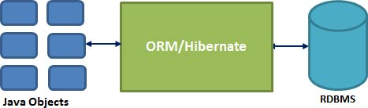

Slide 6

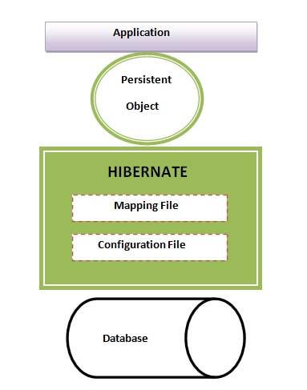
The Hibernate architecture is categorized in four layers:
Java application layer
Hibernate framework layer
Backhand api layer
Database layer
5/28/15

Slide 7

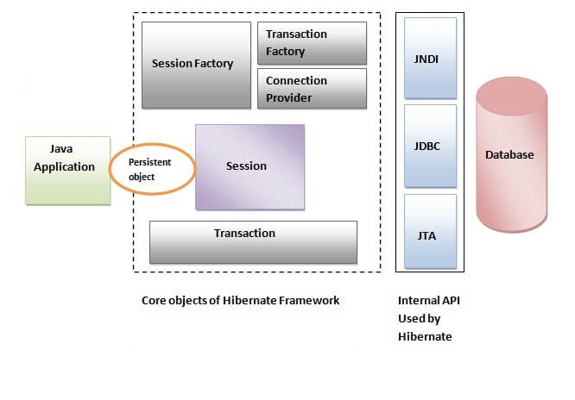

Slide 8

Hibernate takes care of mapping Java classes to database tables using XML files and without writing any line of code.
Provides simple APIs for storing and retrieving Java objects directly to and from the database.
If there is change in Database or in any table then the only need to change XML file properties.

Slide 9

Abstract away the unfamiliar SQL types and provide us to work around familiar Java Objects.
Hibernate does not require an application server to operate.
Manipulates Complex associations of objects of your database.

Slide 10

HSQL Database Engine
DB2/NT
MySQL
PostgreSQL
FrontBase
Oracle
Microsoft SQL Server Database
Sybase SQL Server
Informix Dynamic Server

Slide 11

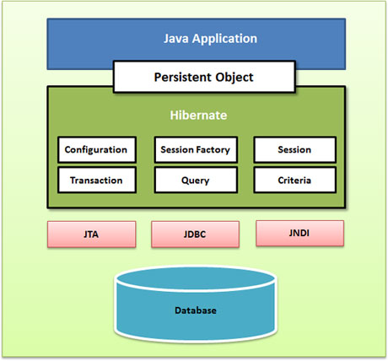

Slide 12

The Configuration object is the first Hibernate object you create in any Hibernate application and usually created only once during application initialization. It represents a configuration or properties file required by the Hibernate. The Configuration object provides two keys components:

Slide 13

Database Connection: This is handled through one or more configuration files supported by Hibernate. These files are hibernate.properties and hibernate.cfg.xml.
Class Mapping Setup
This component creates the connection between the Java classes and database tables.
5/28/15

Slide 14

The SessionFactory is heavyweight object .
it is created during application start up and kept for later use.
SessionFactory object per database using a separate configuration file.
So if we are using multiple databases then we have to create multiple SessionFactory objects.

Slide 15

Session is used to get a physical connection with a database. The Session object is lightweight and designed to be instantiated each time an interaction is needed with the database.
Persistent objects are saved and retrieved through a Session object.
The session objects should not be kept open for a long time because they are not usually thread safe and they should be created and destroyed them as needed.

Slide 16

Transaction represents a unit of work with the database and most of the RDBMS supports transaction functionality. Transactions in Hibernate are handled by an underlying transaction manager and transaction (from JDBC or JTA).

Slide 17

Query objects use SQL or Hibernate Query Language (HQL) string to retrieve data from the database and create objects. A Query instance is used to bind query parameters, limit the number of results returned by the query, and finally to execute the query.

Slide 18

Criteria object are used to create and execute object oriented criteria queries to retrieve objects.

Slide 19

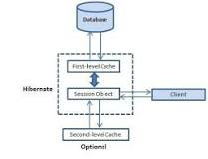
The first level cache is the session cache.
Objects are cached within the current session and they are only alive until the session is closed.
The second level cache exists as long as the session factory is alive.

Slide 20

http://www.java2s.com/Code/Jar/h/Downloadhibernate4jar.htm

Slide 21

Properties and Description
hibernate.dialect This property makes Hibernate generate the appropriate SQL for the chosen database.
hibernate.connection.driver_class The JDBC driver class.
hibernate.connection.url The JDBC URL to the database instance.
hibernate.connection.username The database username.
hibernate.connection.password The database password.
hibernate.connection.pool_size Limits the number of connections waiting in the Hibernate database connection pool.
hibernate.connection.autocommit Allows autocommit mode to be used for the JDBC connection.

Slide 22

<?xml version="1.0" encoding="utf-8"?>
<!DOCTYPE hibernate-configuration SYSTEM
"http://www.hibernate.org/dtd/hibernate-configuration-3.0.dtd">
<hibernate-configuration>
<session-factory>
<property name="hibernate.dialect">
org.hibernate.dialect.MySQLDialect
</property>

Slide 23

<property name="hibernate.connection.driver_class">
com.mysql.jdbc.Driver
</property>
<!-- Assume test is the database name -->
<property name="hibernate.connection.url">
jdbc:mysql://localhost/test
</property>
5/28/15

Slide 24
<property name="hibernate.connection.username">
root
</property>
<property name="hibernate.connection.password">
root123
</property>
5/28/15

Slide 25
<!-- List of XML mapping files -->
<mapping resource="Employee.hbm.xml"/>
</session-factory>
</hibernate-configuration>
5/28/15

Slide 26

Database | Dialect Property
DB2 | org.hibernate.dialect.DB2Dialect
HSQLDB | org.hibernate.dialect.HSQLDialect
MySQL | org.hibernate.dialect.MySQLDialect
Oracle (any version) | org.hibernate.dialect.OracleDialect
Oracle 11g | org.hibernate.dialect.Oracle10gDialect
Oracle 10g | org.hibernate.dialect.Oracle10gDialect

Slide 27

public class Employee {
private int id;
private String firstName;
private String lastName;
private int salary;
public Employee() {}
// generate getter and Setters
Continue….

Slide 28

public Employee(String fname, String lname, int salary) {
this.firstName = fname;
this.lastName = lname;
this.salary = salary;
}
// add setter and getter methods
5/28/15

Slide 29

<?xml version="1.0" encoding="utf-8"?>
<!DOCTYPE hibernate-mapping PUBLIC
"-//Hibernate/Hibernate Mapping DTD//EN"
"http://www.hibernate.org/dtd/hibernate-mapping-3.0.dtd">
<hibernate-mapping>
<class name="Employee" table="EMPLOYEE">

Slide 30
<meta attribute="class-description">
This class contains the employee detail.
</meta>
<id name="id" type="int" column="id">
<generator class="native"/>
</id>
5/28/15

Slide 31
<property name="firstName" column="first_name" type="string"/>
<property name="lastName" column="last_name" type="string"/>
<property name="salary" column="salary" type="int"/>
</class>
</hibernate-mapping>
5/28/15

Slide 32

Mapping type | Java type | ANSI SQL Type
integer | int or java.lang.Integer | INTEGER
long | long or java.lang.Long | BIGINT
short | short or java.lang.Short | SMALLINT
float | float or java.lang.Float | FLOAT
double | double or java.lang.Double | DOUBLE
big_decimal | java.math.BigDecimal | NUMERIC
character | java.lang.String | CHAR(1)
string | java.lang.String | VARCHAR
byte | byte or java.lang.Byte | TINYINT
boolean | boolean or java.lang.Boolean | BIT
yes/no | boolean or java.lang.Boolean | CHAR(1) ('Y' or 'N')

Slide 33

Mapping type | Java type | ANSI SQL Type
date | java.util.Date or java.sql.Date | DATE
time | java.util.Date or java.sql.Time | TIME
timestamp | java.util.Date or java.sql.Timestamp | TIMESTAMP
calendar | java.util.Calendar | TIMESTAMP
calendar_date | java.util.Calendar | DATE

Slide 34

import java.util.List;
import java.util.Date;
import java.util.Iterator;
import org.hibernate.HibernateException;
import org.hibernate.Session;
Continue…..

Slide 35

import org.hibernate.Transaction;
import org.hibernate.SessionFactory;
import org.hibernate.cfg.Configuration;
public class ManageEmployee {
private static SessionFactory factory;
public static void main(String[] args) {
5/28/15

Slide 36

try{
factory = new Configuration().configure().buildSessionFactory();
}catch (Throwable ex) {
System.err.println("Failed to create sessionFactory object." + ex);
throw new ExceptionInInitializerError(ex);
}
Continue…..

Slide 37
ManageEmployee ME = new ManageEmployee();
/* Add few employee records in database */
Integer empID1 = ME.addEmployee(“Rama", “Raju", 1000);
Integer empID2 = ME.addEmployee(“Veena", “Vani", 5000);
Integer empID3 = ME.addEmployee("Janardhan", “Rai", 10000);
/* List down all the employees */
ME.listEmployees();
5/28/15

Slide 38
/* Update employee's records */
ME.updateEmployee(empID1, 5000);
/* Delete an employee from the database */
ME.deleteEmployee(empID2);
/* List down new list of the employees */
ME.listEmployees();
}
Continue…..

Slide 39

public Integer addEmployee(String fname, String lname, int salary){
Session session = factory.openSession();
Transaction tx = null;
Integer employeeID = null;
try{
tx = session.beginTransaction();
Continue…..

Slide 40

Employee employee = new Employee(fname, lname, salary);
employeeID = (Integer) session.save(employee);
tx.commit();
}catch (HibernateException e) {
if (tx!=null) tx.rollback();
e.printStackTrace();
}
5/28/15

Slide 41

finally { session.close(); }
return employeeID;
}
/* Method to READ all the employees */
public void listEmployees( ){
Session session = factory.openSession();
Transaction tx = null;
5/28/15

Slide 42

try{
tx = session.beginTransaction();
List employees = session.createQuery("FROM Employee").list();
for (Iterator iterator = employees.iterator(); iterator.hasNext();){
Employee employee = (Employee) iterator.next();
Continue…..

Slide 43

System.out.print("First Name: " + employee.getFirstName());
System.out.print(" Last Name: " + employee.getLastName());
System.out.println(" Salary: " + employee.getSalary());
}
tx.commit(); }
5/28/15

Slide 44

catch (HibernateException e) {
if (tx!=null) tx.rollback();
e.printStackTrace();
}finally {
session.close();
}
}
5/28/15

Slide 45

/* Method to UPDATE salary for an employee */
public void updateEmployee(Integer EmployeeID, int salary ){
Session session = factory.openSession();
Transaction tx = null;
try{
tx = session.beginTransaction();
Continue…..

Slide 46

Employee employee = (Employee)session.get(Employee.class, EmployeeID);
employee.setSalary( salary );
session.update(employee);
tx.commit();
}
5/28/15

Slide 47
catch (HibernateException e) {
if (tx!=null) tx.rollback();
e.printStackTrace(); }
finally {
session.close(); }
}
5/28/15

Slide 48

/* Method to DELETE an employee from the records */
public void deleteEmployee(Integer EmployeeID){
Session session = factory.openSession();
Transaction tx = null;

Slide 49

try{
tx = session.beginTransaction();
Employee employee =
(Employee) session.get( Employee.class, EmployeeID);
session.delete(employee);
tx.commit();
}
5/28/15

Slide 50
catch (HibernateException e) {
if (tx!=null) tx.rollback();
e.printStackTrace(); }
finally {
session.close();
}
} }

